Slide 1
Data Structures

Slide 2

I know Programming, What is the Problem
Why does it run out of Memory
Why my Program is Slow
Programmer

Slide 3
Towards Problem Solving
TO
Selecting The Best

Slide 4
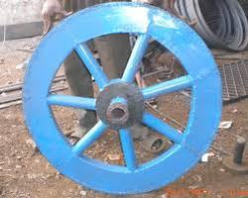
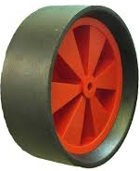







Designing a Tyre
Wood
Iron
Plastic
Iron
Rubber

Slide 5



Selection of Tyre

Slide 6



Selecting the Best

Slide 7

Best Fit

Slide 8
Best Fit

Slide 9
Best Fit

Slide 10

Data Everywhere!
Data Generated in one flight from NY to London:
Google Searches Per second:
40000
DATA
Numbr of tweets per day on twitter:
400 Million
No of Youtube videos watched per second:
41,46,600
90
%
OF THE WORLD’S DATA WAS GENERATED IN THE
LAST TWO YEARS
No of photos uploaded per day in facebook:
300 million
No of trips in Uber every mniute:
45,788
The S, R and M of Data
Number of likes in facebook each day:
3.5 billion
No of photos and videos shared on instagram everyday:
95 million
Store
Retrieve
Manipulate
10

Slide 11
How long does it take took to scan 8 billion pages (google)?
Now you are searching the word “Presidency”!
Google index 8 billion pages.
Assume each page has 100 words (which is a humble number)
Each word has 10 letters, each letter is one byte
It takes around 21 hours to perform a linear scan of 8 billion pages!
Word Wide Wait!

Slide 12
Search for Bus number 502 in Majestic Bus Stand
First Option
203 | 201 | 501 | 404 | 103 | 302 | 101 | 204 | 401 | 104 | 504 | 303 | 301 | 402 | 502 | 202 | 102 | 304 | 403 | 104 | 503

Slide 13
Search for Bus number 502 in Majestic Bus Stand
Second Option
101 | 102 | 103 | 104 | 201 | 202 | 203 | 204 | 301 | 302 | 303 | 304 | 401 | 402 | 403 | 404 | 501 | 502 | 503 | 504

Slide 14
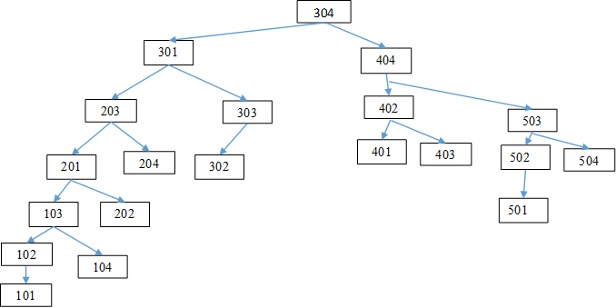
Search for Bus number 502 in Majestic Bus Stand
Third Option

Slide 15
Search for Bus number 502 in Majestic Bus Stand
First Option
203 | 201 | 501 | 404 | 103 | 302 | 101 | 204 | 401 | 104 | 504 | 303 | 301 | 402 | 502 | 202 | 102 | 304 | 403 | 104 | 503
Second Option
101 | 102 | 103 | 104 | 201 | 202 | 203 | 204 | 301 | 302 | 303 | 304 | 401 | 402 | 403 | 404 | 501 | 502 | 503 | 504
Third Option

Slide 16

What is Data Structure?
Data on its own is useless unless you can make sense of it!
WHAT IS Data Structure?
The scientific process of transforming data into insight for making better decisions, offering new opportunities for a competitive advantage

Slide 17
What is Data Structure? Make it simple
Wikipedia: In computer science, a data structure is a data organization, management, and storage format that enables efficient access and modification.
More precisely, a data structure is a collection of data values, the relationships among them, and the functions or operations that can be applied to the data.
Data Structure= Related Data + Operations
Operation include, Storing, Searching, Deleting, Updating, Comparing, Analyzing, Sorting…

Slide 18
Classification of Data Structure
Data structure
Primitive DS
Non-Primitive DS
Integer
Float
Character
Pointer
Integer
Float
Float

Slide 19
Classification of Data Structure
Non-Primitive DS
Linear List
Non-Linear List
Array
Queue
Graph
Trees
Link List
Stack

Slide 20
Common Data Structures
List (Array, Linked List)
Stack
Queue
Tree
Heap
Hash Table
Priority Queue

Slide 21

Why Study Algorithms and Data Structures?
World domination

Slide 22
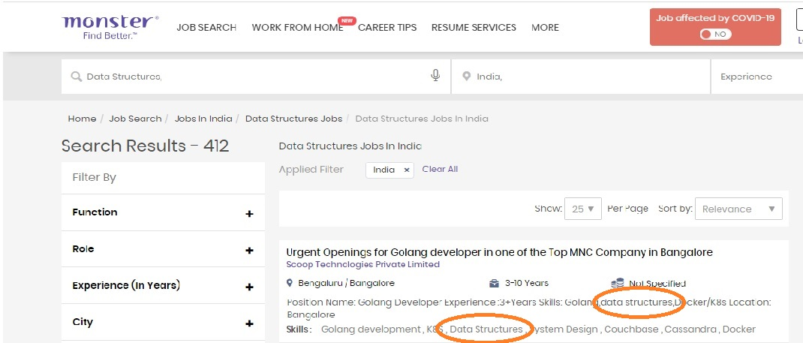
Job Descriptions on Data Structures : August 2020

Slide 23
Job Description: National Security Agency
NSA is in search of Computer Science professionals to solve complex problems, test innovative approaches and research new solutions to storing, manipulating, and presenting information. We are looking for you to apply your computer science expertise to projects that seek to create new standards for the transformation of information. If you want to develop technologies and tools and be a part of cutting edge innovations ' join our team of experts! Help protect national security interests as part of the world's most advanced team of computer science professionals! DCIPS DisclaimerThe National Security Agency (NSA) is part of the DoD Intelligence Community Defense Civilian Intelligence Personnel System (DCIPS). All positions in the NSA are in the Excepted Services under 10 United States Codes (USC) 1601 appointment authority.
As a Computer Scientist, other responsibilities may include:
using principles, techniques, procedures, and tools to architect and facilitate the development of hardware solutions - applying software engineering principles to design and/or develop software applications - developing methods and applications for tools to exploit and analyze computer systems and network vulnerabilities - designing and optimizing algorithms, data structures, modeling, and analytics to solve real-world scientific problems Pay, Benefits, & Work ScheduleOn-the job training, Internal NSA courses, and external training will be made available based on the need and experience of the selectee. Monday - Friday, with basic 8hr/day work requirements between 0600 and 1800 (flexible).
Mandatory Qualification ReqsSalary Range: $70,519 - $87,868 (Entry/Developmental)

Slide 24
Jobs on Data Structures
https://www.naukri.com/data-structures-and-algorithms-jobs
https://www.indeed.co.in/jobs?q=Data+Structure+Algorithm&l=

Slide 26
"The only way to learn a new programming language is by writing programs in it." - Dennis Ritchie
Walking on water and developing software from a specification are easy if both are frozen. - Edward V Berard
We cannot learn without pain. - Aristotle
A person who never made a mistake never tried anything new.
- Albert Einstein

